Slide 1
Welcome to the Department of Sociology and Anthropology

Slide 2
Anthropology and Sociology at Swarthmore
Sociologists and anthropologists study the social structures and cultural systems that create order and meaning in human societies and cultures as well as the pressures and contradictions that produce patterns of conflict and change.
Our department provides classes that are culturally relevant and address important issues such as race relations, health & illness, body & agency, cultural memory & nationalism, the environment & society, food & culture, work & organization, gender & sexuality, migration, cities & urban life, class inequalities, carceral policy, law & society, and civic participation. Students explore these themes in the classroom and through fieldwork and independent study.

Slide 3
Meet Our Anthropology Faculty

Slide 4
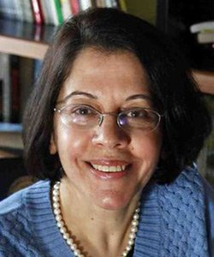
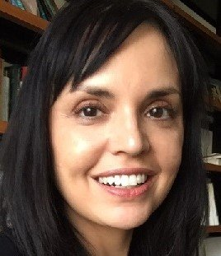
Farha Ghannam, Professor of Anthropology
Urban anthropology; gender inequalities; anthropology of the body; food and culture, anthropological theories; history of ethnography; Globalization/transnationalism; Middle East and North Africa, Egypt and Jordan.
Maya Nadkarni, Associate Professor of Anthropology
Cultural memory and national identity; anthropology of postsocialism and Eastern Europe (Hungary); visuality, mass media, and visual anthropology; anthropology of gender and the family; anthropology of knowledge; genetics, temporality, and risk. On sabbatical 2023-24
Christy Schuetze, Associate Professor of Anthropology
Anthropology of Africa; anthropology of religion; medical anthropology; globalization; anthropology of development; health and society; Pentecostal-Charismatic Christianity; environmental anthropology; post-colonial economics and gender; state and traditional relations in governance.

Slide 5
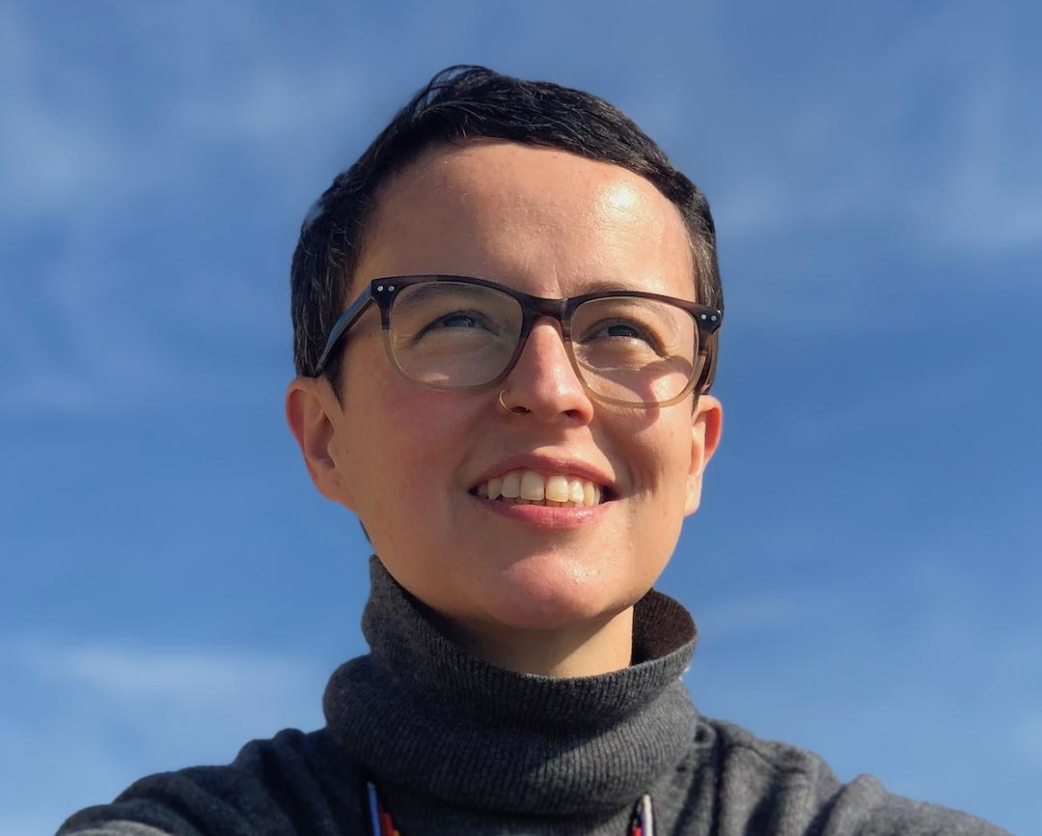
Alejandra Azuero-Quijano, Assistant Professor of Anthropology
Anthropology of law; theories of justice; liberalism; anthropology of finance; humanitarianism; digital ethnography; feminisms/feminist theory; anthropology of Latin America; Colombia.
On sabbatical 2024-25

Slide 6
Meet Our Sociology Faculty

Slide 7
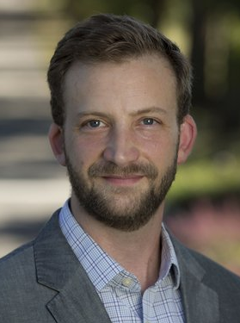
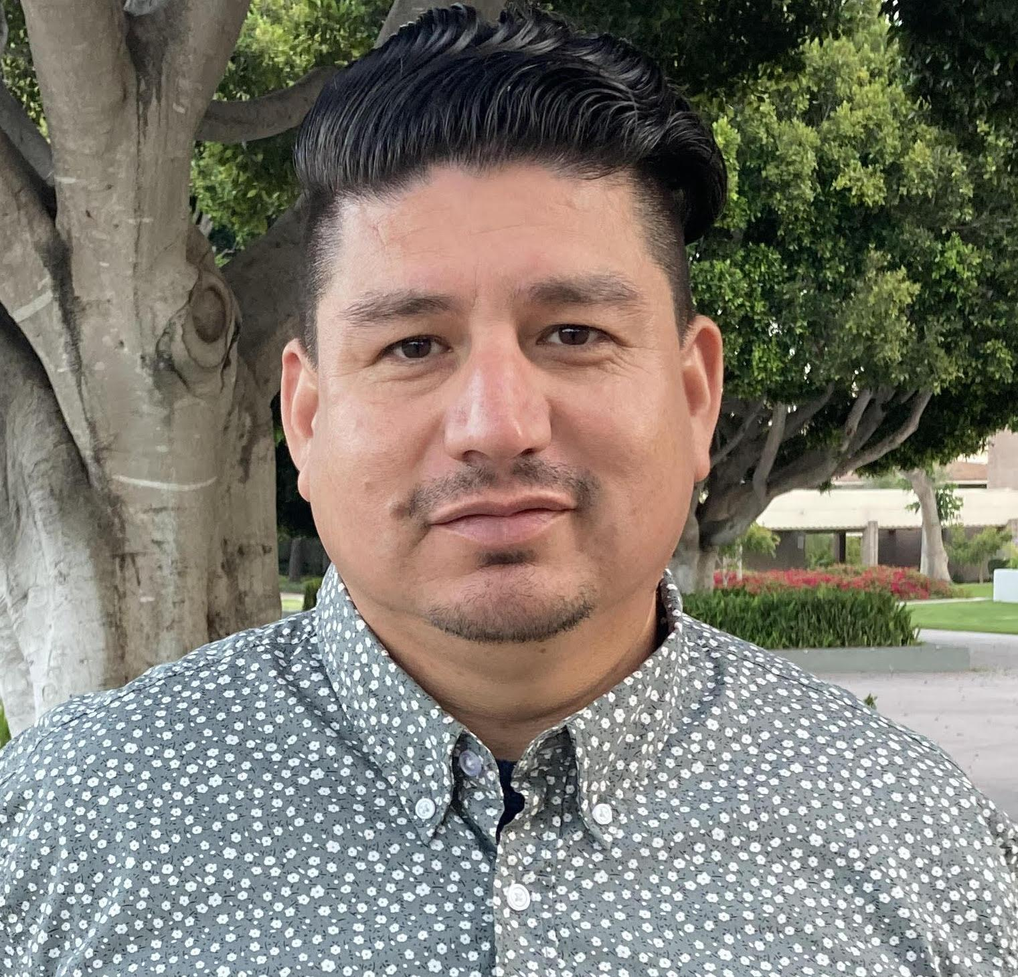
Nina Johnson, Associate Professor of Sociology
Politics; Culture; Race; Class Mobility; Inequality; Cities; Carceral Policy; Qualitative methods.
Daniel Laurison, Assistant Professor of Sociology
Politics; Political participation and engagement; Class/Inequality/Stratification/Mobility; Quantitative methods.
Salvador Rangel, Assistant Professor of Sociology
Class; Race; Migration and illegality; Citizenship, Inequality; Marxism and socialism; Social psychology. On sabbatical 2023-24

Slide 8
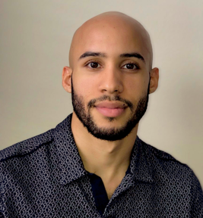
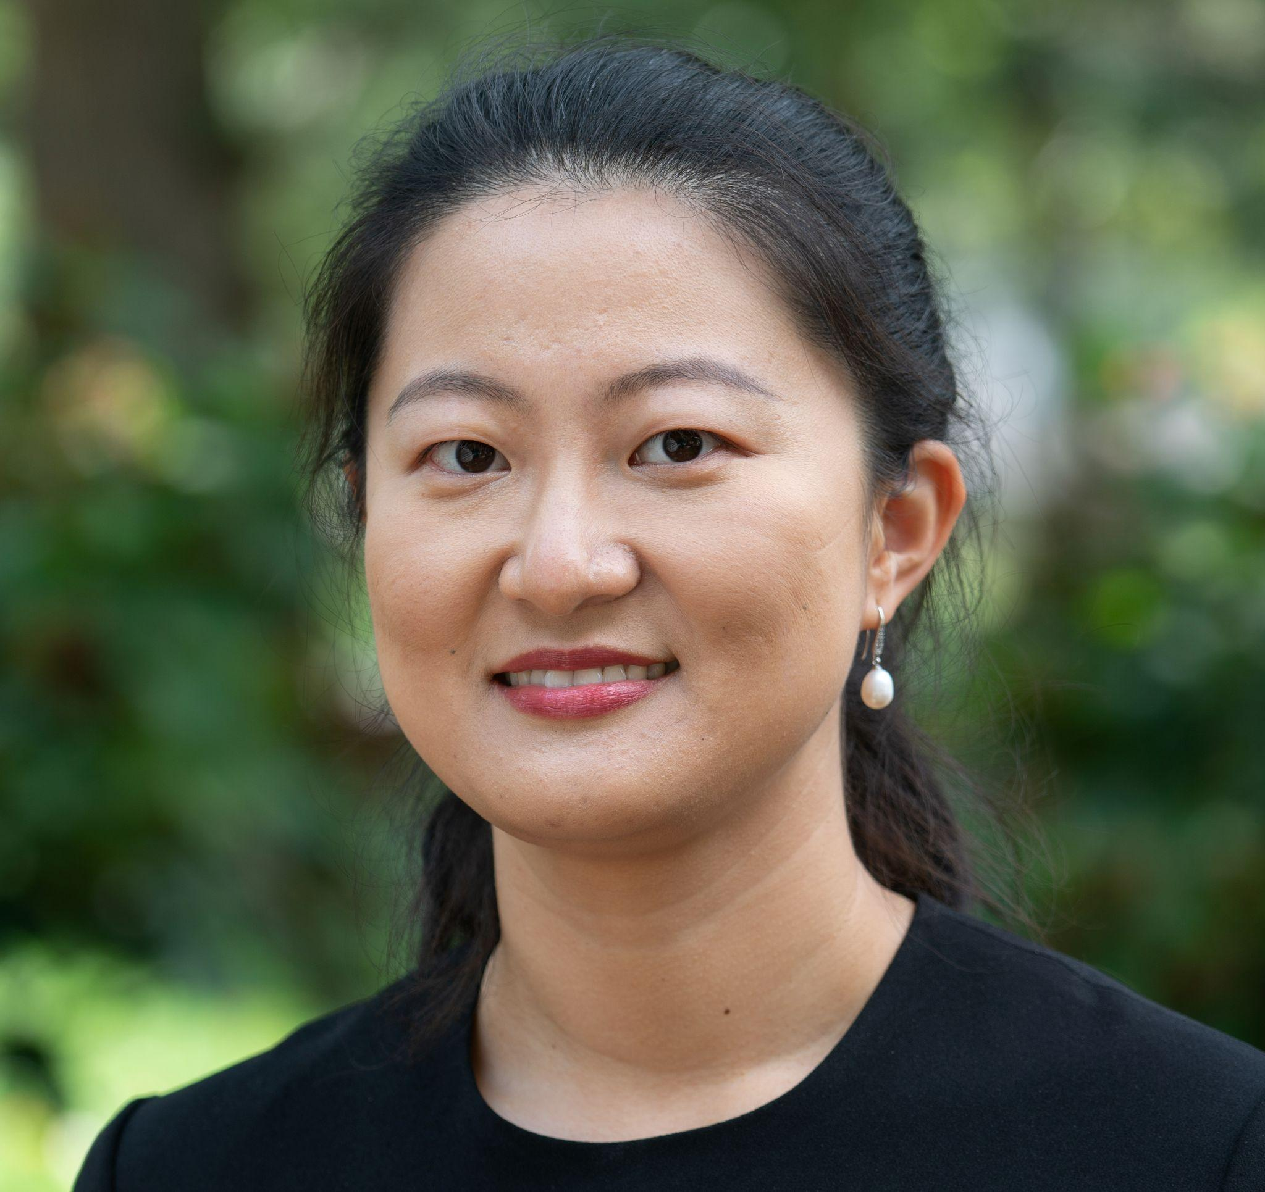
Edlin Veras, Visiting Assistant Professor Racialization Processes; Colorism; Immigration; Colonialism; Qualitative Methods
Ya Su, Visiting Assistant Professor Marriage and Family, Gender and Sexuality; Research Methods and Social Statistics, Law and Society, China and East Asia

Slide 9
Core (required) Courses for Majors
ANTH 001. Foundations: Culture, Power, and Meaning
SOCI 001. Foundations: Self, Culture, and Society
At least one designated Methods course
A 2-credit senior research project (SOAN 098, SOAN 096/097 or SOAN 180F/180S)
Senior Research Project Master Class (SOAN 098)

Slide 10
Departmental Credit Requirements
Course Major: at least 8 credits; Core Courses + 3 add’l courses in the dept
Course Minor: Not offered
Special Major: at least 9 credits; Core Courses + four credits outside of the dept
Special Major: Medical Anthropology: at least 10 credits; ANTH 001, one Methods course in the department, Sr Rsch Prj + either ANTH 043E or ANTH 049B + five add’l courses, recommended: ANTH 002F; 003G; 039C; 053B; 103; 133; SOCI 050B; POLS 048; ECON 075; ENVS 035; LITR 074F; HIST 066; HIST 80; PSYC 38; RELG 031; RELG 033 Please note that no more than one credit from any single department outside of SOAN will be counted toward this special major
Special Major: Political Sociology: at least 10 credits; SOCI 001, one Methods course in the department, Sr Rsch Prj + six add’l courses, recommended: SOCI 006, SOCI 025B/PEAC 025B, SOCI 025C, SOCI 026B, SOCI 035B, SOCI 035D, SOCI 035F, SOCI 045C, SOCI 048G, SOCI 048K, SOCI 048L, SOCI 058C, SOCI 056C, SOCI 138, SOCI 148, ANTH 037B, ANTH 037C, ANTH 042D, ANTH 044/PEAC 043, ANTH 072C, ECON 013, ECON 041, ECON 042, ECON 073, ECON 082, PEAC 014, PEAC 055, PEAC 135/SOCI 135, POLS 020B, POLS 028, POLS 031, POLS 054, POLS 081 Please note that no more than one credit from any single department outside of SOAN will be counted toward this special major

Slide 11
Honors Major: Core Courses (thesis will be used as a preparation) + Two add’l 2-credit preparations in dept
Honors Minor: ANTH 001, SOCI 001, at least one designated Methods course + One 2-credit preparation in the dept
Honors Special Major: Core Courses (thesis will be used as a preparation) + maximum of four credits outside of the dept + Three 2-credit preparations
Honors in Medical Anthropology: requirements for Medical Anthropology + Three 2-credit preparations approved by the dept (thesis will be used as a preparation) Honors in Political Sociology: requirements for Political Sociology course major + Three 2- credit preparations approved by the dept (thesis will be used as a preparation)

Slide 12
Senior Research Project
Our majors conduct original research and will present passionately about significant and timely issues.
Recent topics include: Doula Work and Black Maternal Health; Colorism and Ideals of Beauty; Class Identity and Political Participation; Chronic Pain and Social Media; Food and Identity; Health Care and the Legal System; and Queer Spaces and Identities.
Please visit the thesis posters displayed in our department on Kohlberg’s second floor.
Archived theses available to view in print in Kohlberg 236 and through the library

Slide 13
Medical Anthropology
Offers students the opportunity to tailor a scholarly exploration of medicine, health, and illness with a foundation in anthropology.
A dynamic subfield of the discipline that offers important theoretical, critical, and comparative perspectives to the study of medical systems and healing practices in different cultures,
Provides ways to shape the work and practices of medical institutions and professionals.
Pays attention not only to biomedicine and scientific knowledge, but also to diverse ways of healing, managing pain, and defining wellbeing.
Pays close attention to the different local, national, and global forces that shape the health and wellbeing of various groups and their access to resources and knowledges.
Of particular interest to students interested in graduate work in medical anthropology, the study of medicine, and those planning on pursuing training and work in diverse professions of the health field.

Slide 14
Political Sociology
The special major in Political Sociology offers students an opportunity to ground their inquiries into all things political--political economy, forms of political order and organization, regime formation and revolution, political action, parties and elections, policy, status, power--in a sociological approach that seeks to interrogate and understand social structures and insists that politics must be treated as fully implicated in every facet of the social order, from institutional arrangements to social relations. Political Sociology encompasses a wide variety of theoretical and methodological approaches with which sociologists attempt to describe and explain political phenomena. We cover a wide range of areas within the field, including race, class, migration, colonization, imperialism, public policy, urban politics, social movements, state-formation, revolutions, and cross-national social policy and policy outcomes.

Slide 15
A B.A. in Sociology and Anthropology...
Prepares for future graduate work in anthropology, business, communications, design, education, ethnic and gender studies, international studies, journalism, medicine, public health, research, and sociology
Offers valuable preparation entry level positions in business, colleges/universities, communications, counseling, education, government, health and human services, law, the media, medicine, museums, politics, research, fields that involve investigative skills and working with diverse groups
You will find sociologists and anthropologists addressing social and cultural consequences of natural disasters, equitable access to limited resources, human rights, research partnerships, assessing economic needs, evaluating policies, developing new educational programs, recording little-known community histories, providing health services, and other socially relevant activities.
For more info, visit www.asanet.org/about/sociology.cfm and www.americananthro.org/

Slide 16
Our alumni have gone on to become distinguished anthropologists and sociologists, successful lawyers, dedicated physicians, passionate teachers, and outstanding participants in many other fields.

Slide 17
Where to find us
Second Floor of Kohlberg, Office Kohlberg 232
Sociology and Anthropology Website: https://www.swarthmore.edu/sociology-anthropology
Sociology and Anthropology Fall 2024- Spring 2026 Courses: https://www.swarthmore.edu/sociology-anthropology/current-courses
Sociology and Anthropology Catalog: https://catalog.swarthmore.edu/preview_program.php?catoid=7&poid=292
Sociology and Anthropology, All Courses: https://catalog.swarthmore.edu/preview_program.php?catoid=7&poid=292#anthropologycourses

