Slide 1
Chrome River Invoice
User Manual
Swarthmore College
Accounts Payable

Slide 2
Contacts
Deb Casteel - Accounts Payable Coordinator – dcastee1@Swarthmore.edu – x8366
Deb McGinnis – Accounts Payable Clerk – dmcginn1@Swarthmore.edu – x8391
Beth Baksi – Associate Controller – ebaksi1@Swarthmore.edu – x2042
Carrie DiEnna – Controller – cdienna1@Swarthmore.edu – x7686

Slide 3
What is Chrome River Invoice?
A cloud-based unified solution for automating the College’s Accounts Payable processes
Allows departments to electronically route invoices for departmental approval and then to Accounts Payable for payment
Provides visibility of where an invoice is in the approval and payment process
Purchase Order management within one system allowing the user to apply an invoice to a PO, while also seeing the remaining encumbrance on the PO
Communication with Accounts Payable documented at the invoice level rather than through your email
Ability to view invoices for future reference
Chrome River Invoice allows users to create, submit, and approve invoices anytime, anywhere, and on any device, providing you with the flexibility you need for an efficient workflow

Slide 4
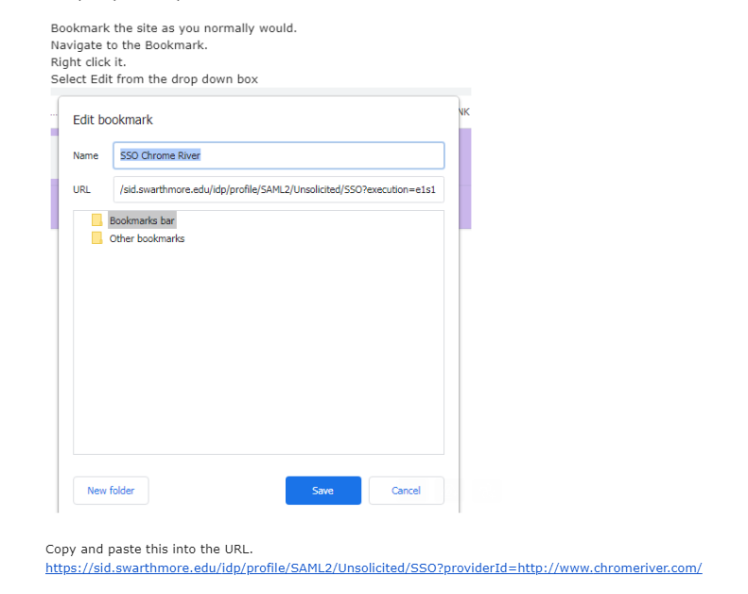
Chrome River Landing Page
Bookmark page
Sign onto Chrome River using your Swarthmore Signal Sign-On

Slide 5
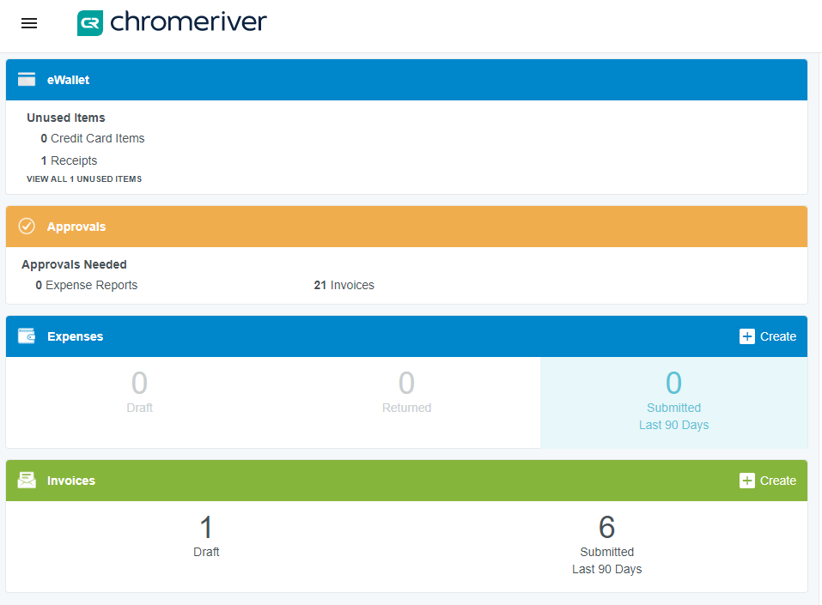
Creating an Invoice for Payment – Direct Pay
“What is a Direct Pay Invoice?”
An invoice that does NOT
have a PO
Step 1
Have your invoice in PDF format in your email or saved
Click on the in the “Invoices” section of the landing page

Slide 6
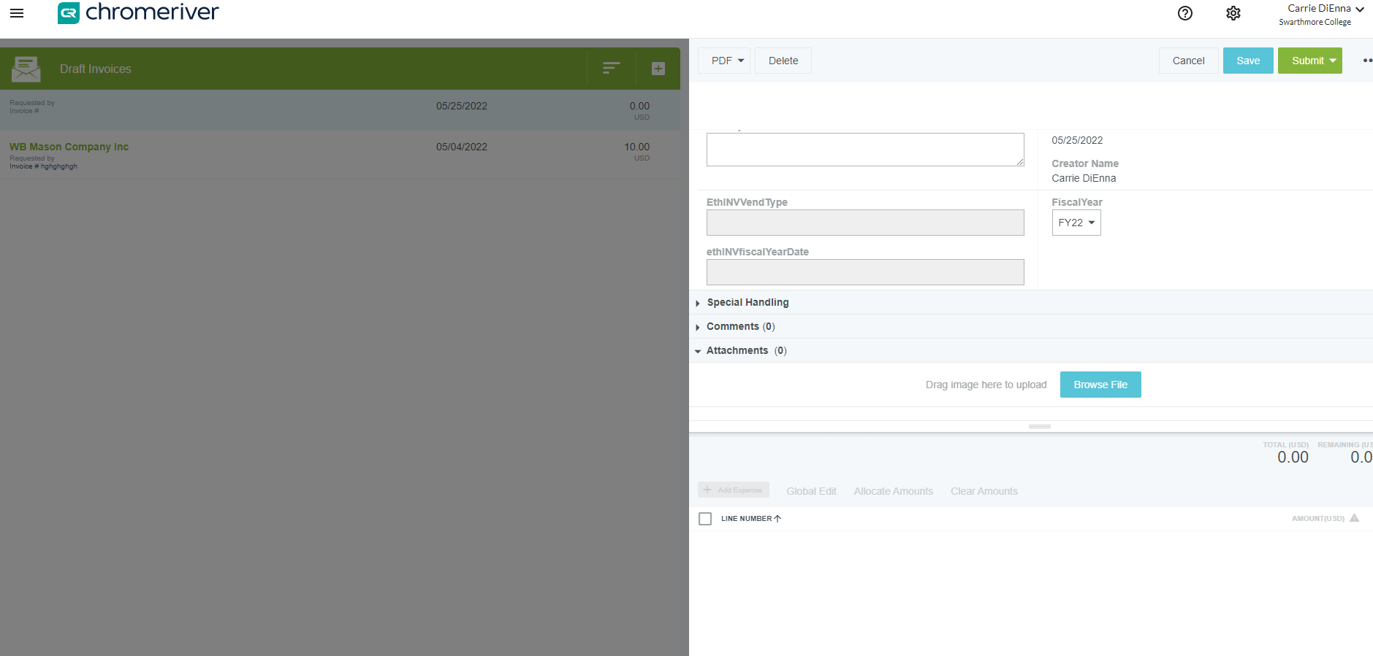
Creating an Invoice for Payment – Direct Pay
Step 2
Image will appear here
Drag and Drop Image or Browse

Slide 7
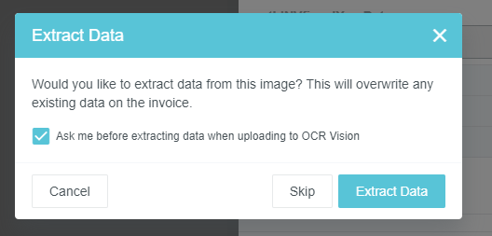
Creating an Invoice for Payment – Direct Pay
Chrome River provides OCR (optical character recognition) which is technology that recognizes text within a digital image. This technology permits the user to upload an image into Chrome River and will complete some of the necessary fields such as vendor name, vendor address, invoice number, & invoice date. To use OCR, scroll down to the Browse File box & click on it.
Sometimes a vendor’s invoice is not setup to allow OCR to properly extract data
You can this and complete the information manually
You should also if the payment needs to be applied to a PO
If you use OCR, please check that all information was extracted accurately and change anything that was not
The Check Request form is no longer required
Step 3
Complete the header pane
Extract Data (not for PO)
OR
2.Complete Manually

Slide 8
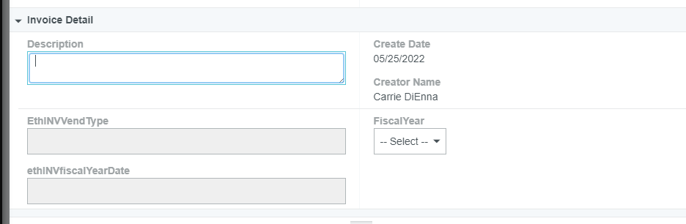
Step 4
Invoice Detail Pane
Creating an Invoice for Payment – Direct Pay
Description – a brief description of the products or services and the reason for their purchase
Fiscal Year – only available for 3 weeks in July
Allows you to charge the prior year budget
This is reviewed by AP and will be changed to conform with accounting guidelines.
Services and products have to be recorded in the year in which the service was provided or the product was delivered

Slide 9
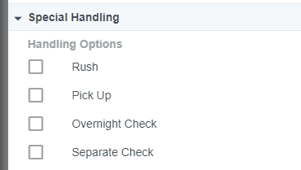
Step 5
Special Handling Pane
Rush – This should only be used for extenuating circumstances.
NOTE: Check runs are on Monday’s and Thursday’s. Currently, the Business Office requires 10 business days from the date AP receives the invoice to process a payment. Please consider this when submitting an invoice payment and plan your submission according to your needs.
Please note in the comments section the reason for the rush.
Pick Up – use this option when you need a physical check to deliver to the vendor. AP will notify you when the check is available for pick up at 101 S Chester Rd
Overnight Check – use if you need AP to overnight your check payment. Make sure to provide all pertinent information
Separate Check – use if this payment cannot be combined with other payments to the same vendor – ex. Vehicle registrations

Slide 10
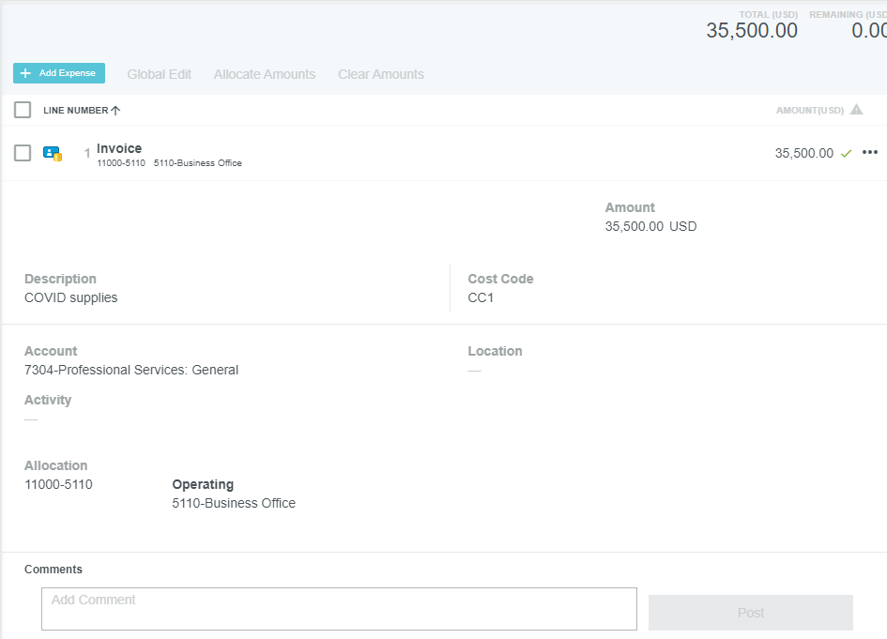

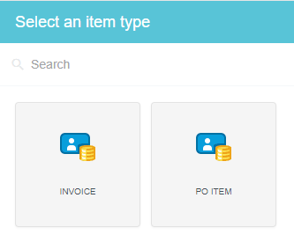

Step 6 – Add Expenses
In the bottom, right pane click
In “Select an Item Type” pane click
Fill in Description, Account, Allocation (fund and organization code) and activity code and/or location, if any
Change amount if it is not the full invoice total
  Multiple lines to charge? Go back to Step 1 and add more
After you are balanced – click Save

Slide 11
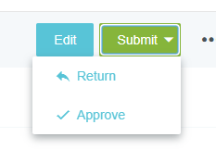
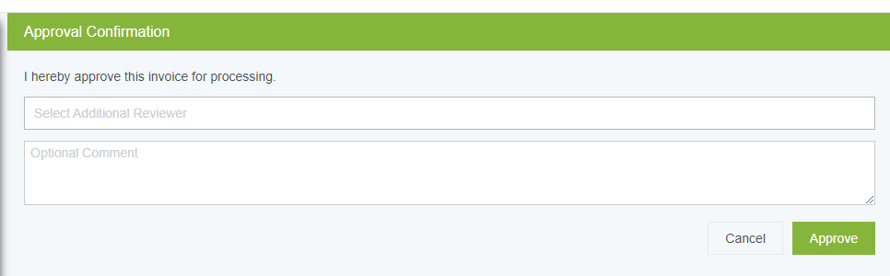
Step 7 – Submit
Submit => Approve
The Approval Confirmation Box allows you to select another user to review this invoice
  If you wish for this invoice to follow our regular routing rules continue with “Approve”

Slide 12

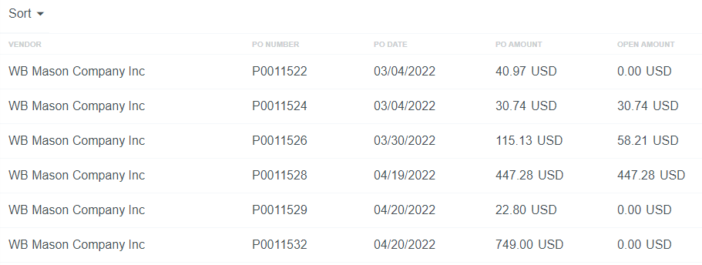
Creating an Invoice to pay against a PO
Follow Steps 1 and 2 from direct pay invoice procedures
At Step 3 hit
Step 4 – for POs only, click Search
  Type in the vendor name and find the PO you want to pay
  Or Type in the PO number, if you know it
  Chrome River will show the total PO amount and how much is left to be paid
Click on the PO you want and hit “Copy”
(bottom, right corner)

Slide 13
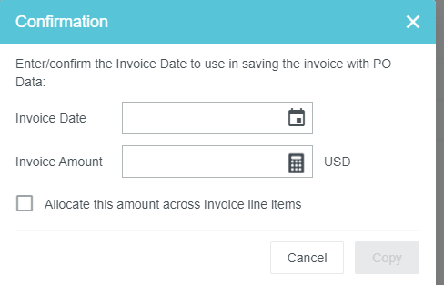
Creating an Invoice to pay against a PO
Step 5 – complete this pop-up box
Do not click on the “Allocate this amount across invoice line items”
“Copy”

Slide 14
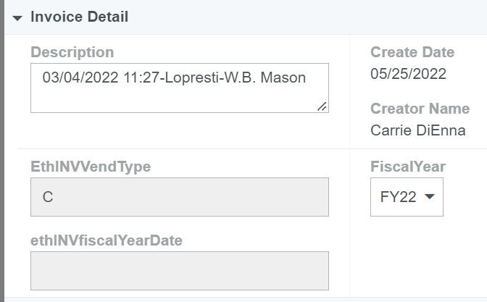
Creating an Invoice to pay against a PO
Step 6 – Invoice Detail pane
Description will automatically generate
Select Fiscal Year
Step 7 – Special Handling pane
(see Step 5 in direct pay invoice)

Slide 15
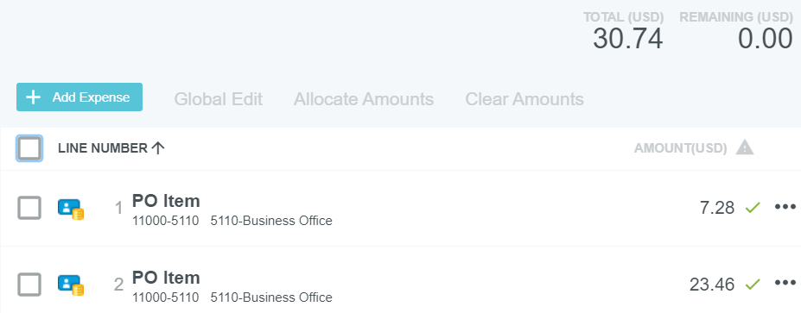
Creating an Invoice to pay against a PO
Step 8a – Charge Expense Lines – Full/Final Payment
Make sure PO line items match invoice
Make sure the Remaining amount is Zero
Step 9 – Submit and Approve Invoice
See step 7 for direct pay invoices

Slide 16

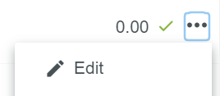
Creating an Invoice to pay against a PO
Step 8a – Charge Expense Lines – Partial Payment
Click the PO line item to expand and show details
Click and “Edit” to edit quantity/amount to match invoice for each PO line item to be paid
Delete any unused PO line item by clicking and selecting “delete”
Click Save

Slide 17
Where does my invoice go after I submit it?
Under $10k => AP
Between $10k and $50k => Financial Manager
Between $50k and $250k => President’s Staff
Greater than $250k => VP for Finance and Administration
AP approves all invoices
Additional approvals for specific funds
  Grant Funds => Grants Accountant, Christy Brydges
  Restricted Funds => Senior Accountant, Denise Risoli
  Plant Funds => Associate Controller, Joe Cataldi
After last approval, the invoice is brought into Banner and will be processed in the next check run

Slide 18
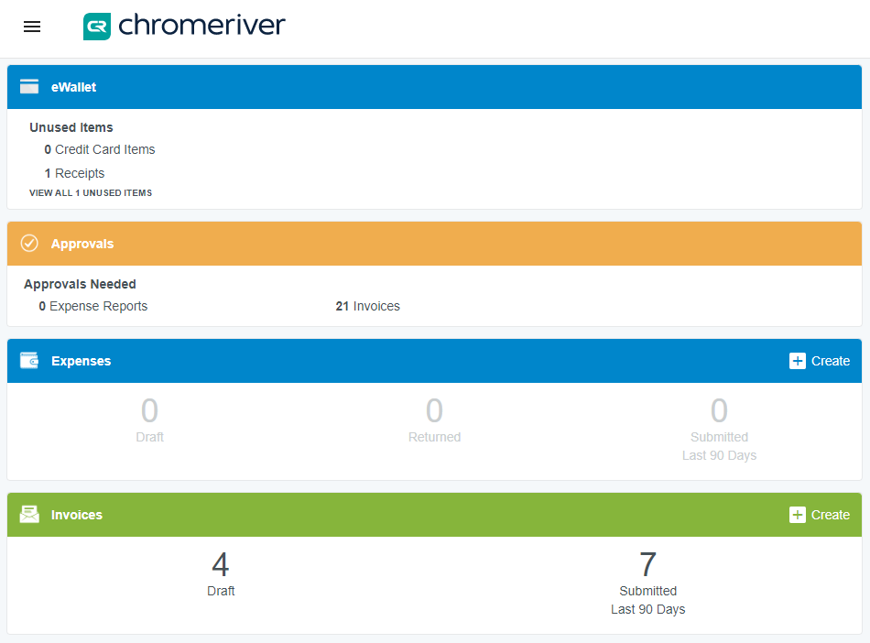
Approving an Invoice for Payment
You will receive an email stating that there are items for you to approve in Chrome River Invoice
Log into Chrome River
In the Approvals section of the landing page, you will see how many invoices are needing your approval. Click on “# Invoices” – a list will appear
Click on the invoice you would like to review/approve

Slide 19
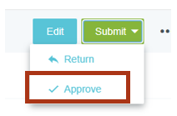
Approving an Invoice for Payment
To edit for all items become available for change
If you want to return it to sender or another employee
If you are ready to submit
  Here you can send to additional reviewers and add comments

Slide 20
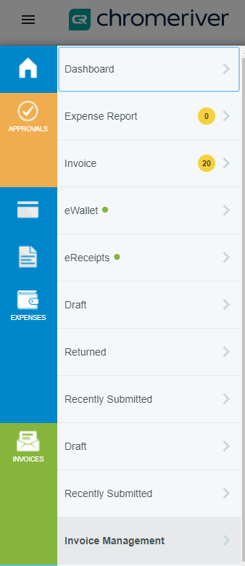
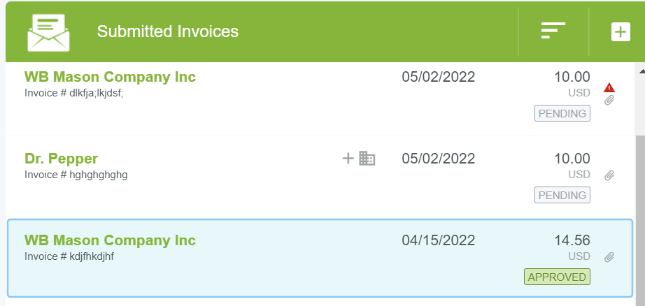
Checking Invoice Status
Click on the “hamburger” at the top, left corner
In the Invoices section, select “Recently Submitted”
The status of the invoice will be shown in the list under the invoice amount

Slide 21
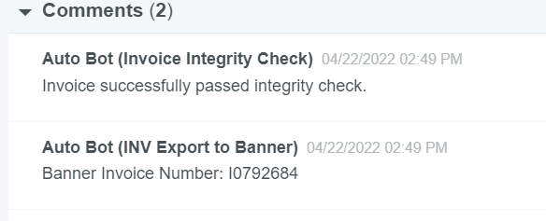
Tracking an Invoice
Select the invoice in your recently submitted list
Click on the “Tracking” button above the invoice to show steps needed for approvals
If Invoice is through approvals and processed in Banner, you will see the Banner document number in the Comments pane

Slide 22

Creating a Temporary Vendor
In Step 3 of “Creating an Invoice – Direct Pay” – select the icon for the drop down list to appear
Click “+ Create Temporary Vendor” at the top of the list
Complete the remaining steps of invoice creation
  Along with the invoice, be sure to include the vendor’s W-9
This will be routed to AP to create a Banner ID
AP will return the invoice to the creator with the Banner ID
The next day, the user can change the vendor to the newly created vendor and resubmit to AP for normal processing
  All new vendors are fed to Chrome River overnight

Slide 23
Creating an Address
Click “+ Create Temporary Address”
This will be routed to AP to create a new address or feed that address into CR
This information is feed to CR from Banner every night
The next day, Accounts Payable will submit the invoice with the correct address for payment

Slide 24
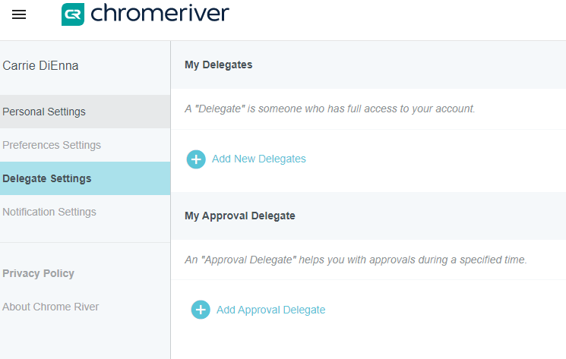
Assigning a Delegate for Approvals
Click on your name (top, right)
Account Settings
Delegate Settings
Add Approval Delegate
Select A User and start/end date
Note: “My Delegates” is only for Chrome River Expense

Slide 25
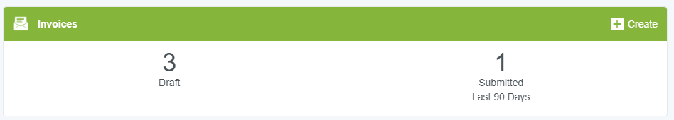
Submitting Invoices via email
Send email with a PDF attachment(s) to
You will get a notification that Chrome River Invoice has created drafts of these invoices
Go to Dashboard => click on the drafts
Complete the remaining steps for invoice creation
If you have a PO, make sure to search and include the PO in the header information and continue with the remaining steps for PO payment
Helpful Tool: if a vendor sends you an email with a PDF copy of the invoice, you can forward that email to the above email address and a draft invoice will be created
  You CANNOT have the vendor send the invoice directly to the Chrome River email address as Chrome River will not recognize the vendor as a user
swarthmore.edu-vision@invoice.ca1.chromeriver.com

Slide 26
FAQs
What do I do If I do not see the fund/org?
  Contact the Financial Manager of that fund/org
Can I upload multiple invoices at once?
  Yes, each invoice has to be a separate PDF document but you can include multiple PDF invoices, and email to the following alias
  swarthmore.edu-vision@invoice.ca1.chromeriver.com

Slide 27
Helpful Links
CR Live Training Webinars provides the ability to sign up for live webinars with Chrome River
CR End User Essentials provides a quick references for “how to’s”
CR Recorded Trainings provides on-demand refreshers with pre-recorded demonstrations

